Slide 1


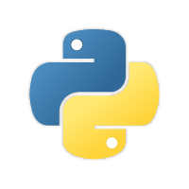
Python Program

Slide 2
Agenda
Python Introduction
Who Uses Python
Python Features
Installations
Keywords in Python
Operators in Python
Flow Control
Functions in Python
Let’s Start

Slide 3

Introduction :
Python is a widely used high-level programming language for general-purpose programming, created by Guido Van Rossum and first released in 1991.
Python is named from name called “Monty Python”.
Python is a simple, easy to learn, powerful, high level and object-oriented programming language.
Python is a general purpose programming language created in the late 1980s, and named after Monty Python, that's used by thousands of people to do things from testing microchips at Intel, to powering Instagram, to building video games with the PyGame library.

Slide 4
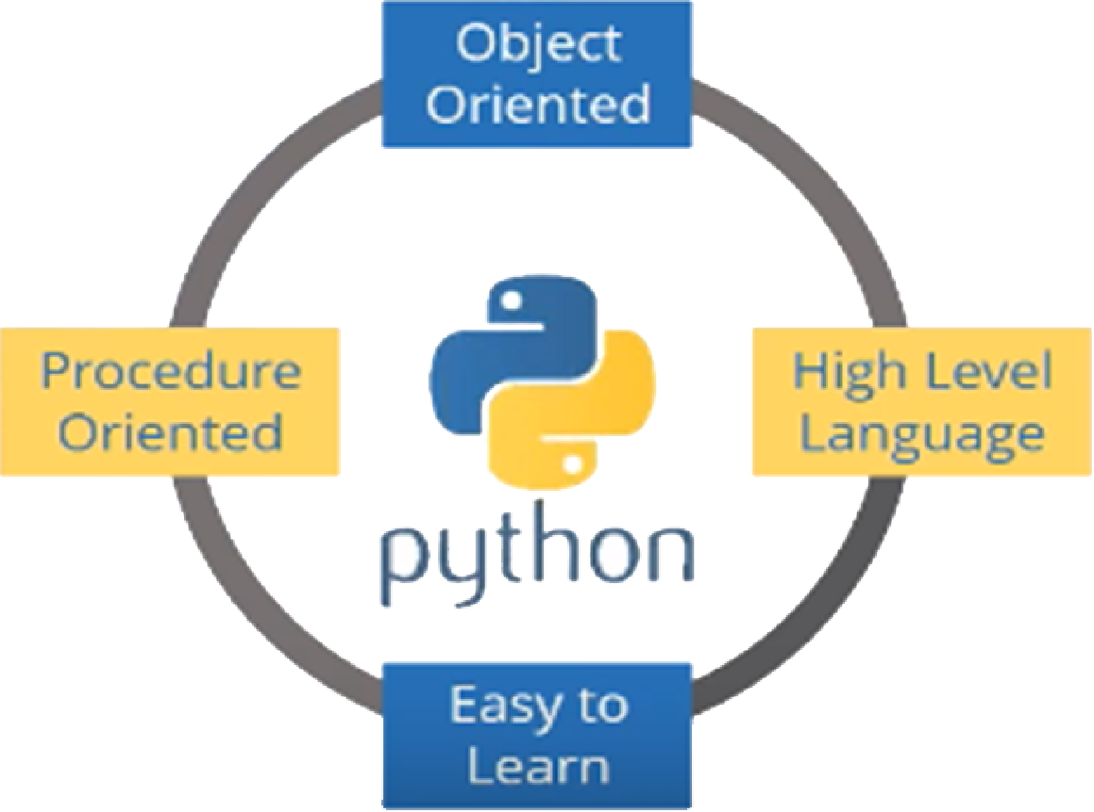
Python is an interpreted, object-oriented, high-level programming language with dynamic semantics.

Slide 5
Who Uses Python ?

Slide 6
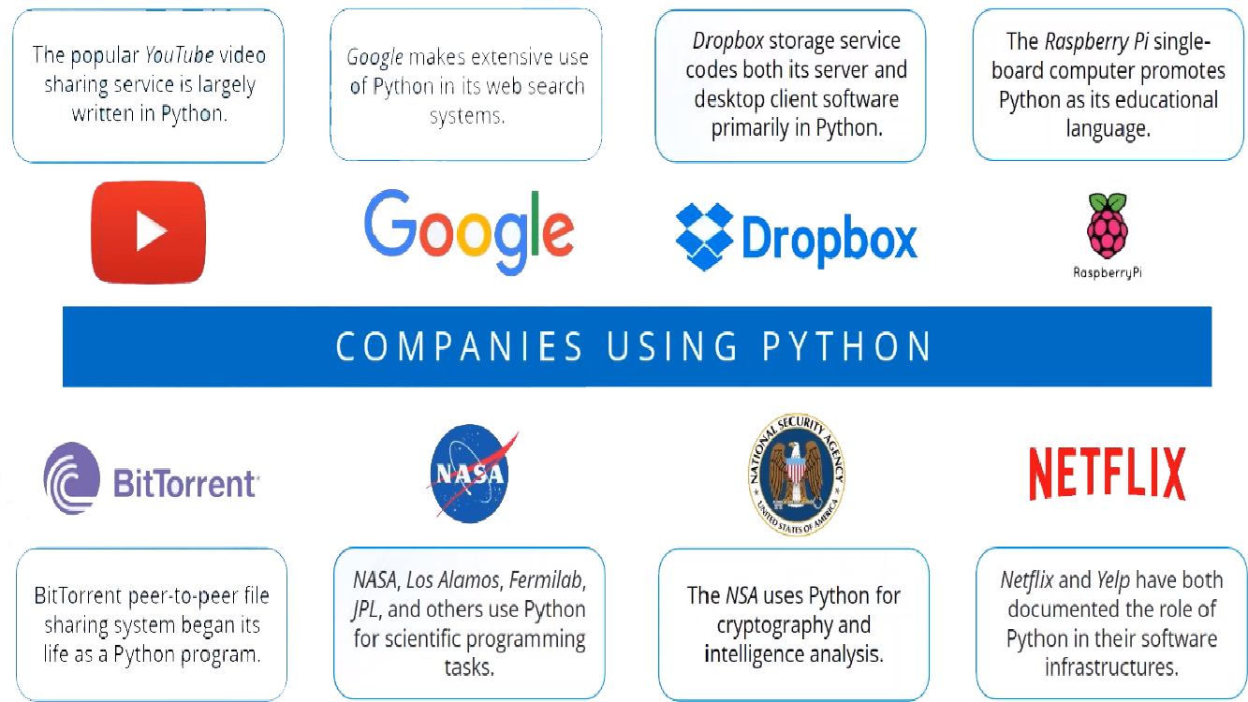

Slide 7



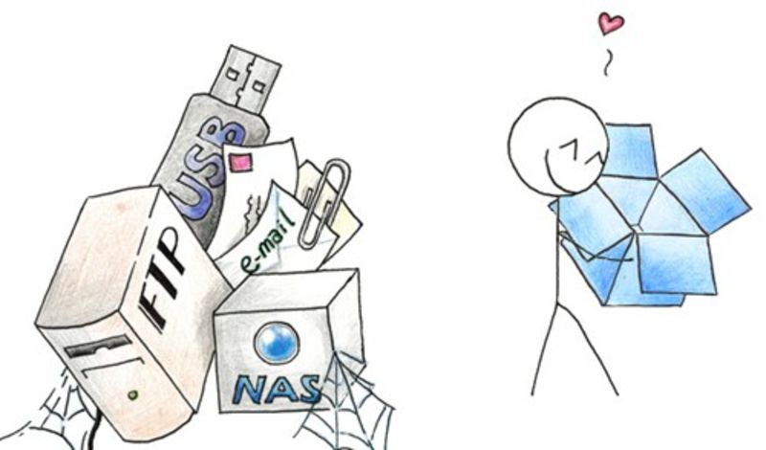
Using Top Companies:
YouTube is originally Written in Python and MySQL.
Yahoo Maps uses Python.
Many Components of the Google Spider and Search engine are Written in Python.
Dropbox web-based file hosting service is implemented using Python

Slide 8
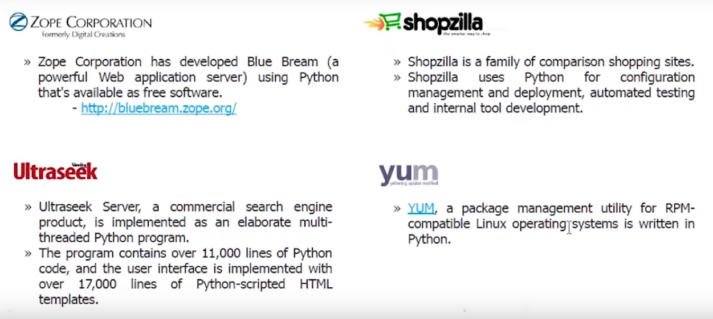
Using Top Companies:

Slide 9






Using Top Companies:
NASA
Walt Disney
AlphaGene
RedHat
Nokia
IBM

Slide 10

Python Features

Slide 11
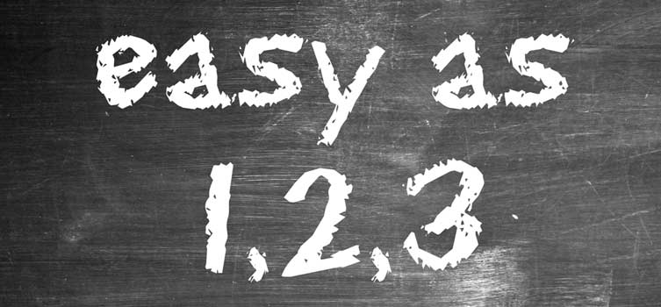
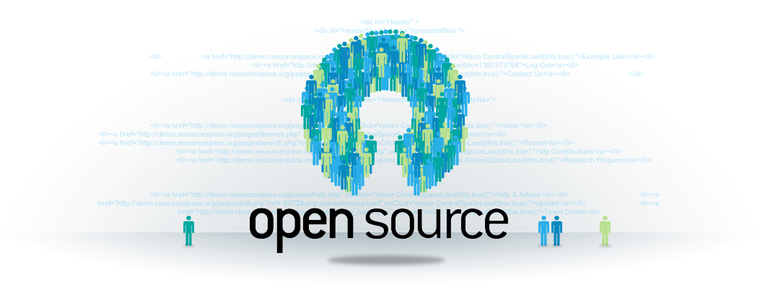
Python Features
Simple and Easy to Learn
Python is a simple and easy to learn, read & write
Free and Open Source
Python is an example of FLOSS(Free/Libre and Open Source
Software) which means one can freely distribute copies of this
software, read it’s source code, modify it, etc.

Slide 12
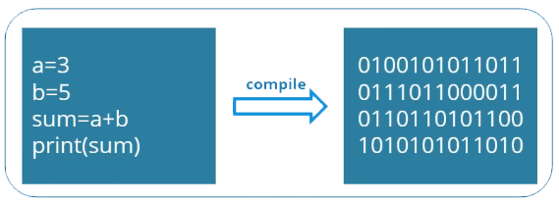


Python Features
High-level Language
One does not need to bother about the low-level
details like memory allocation, etc. while writing
Python Scripts
Portable
Supported by many platforms like Windows CE, Linux, Windows,
FreeBSD, Macintosh, Solaris, OS/2, Amiga, AROS, AS/400, BeOS,
OS/390, PlayStation, etc.

Slide 13
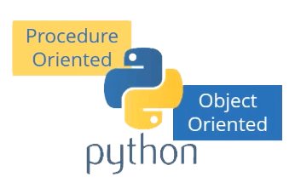
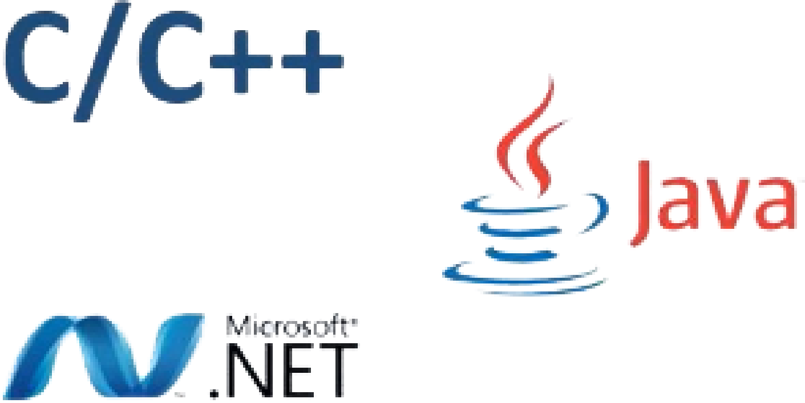
Python Features
Supports different Programming Paradigm
Python Supports procedure-oriented programming as well as
object-oriented programming.
Extensible
Python code can invoke C and C++ libraries, can be called from and C++ programs, can integrate with Java and . Net components
We can perform Cross-Language Operations

Slide 14

Download & Installation

Slide 15
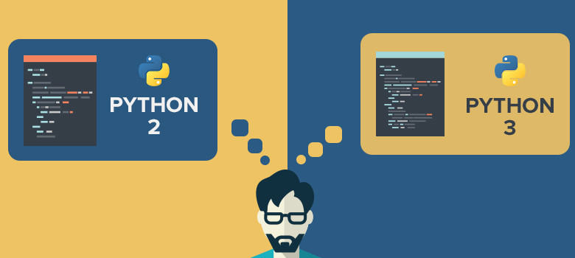
Versions :

Slide 16
Versions :
Python 2 | Python 3
print “Hello World..!” | Print(“Hello World..!”)
Less Support Documentation Libraries | More Support Documentation Libraries
Less Performance while Compare to Python3 | Better Performance
Not as ready | Ready to Move into the future(Updates)
No Full Support for Readymade Modules and Libraries | Full Support of Readymade Modules and Libraries

Slide 17
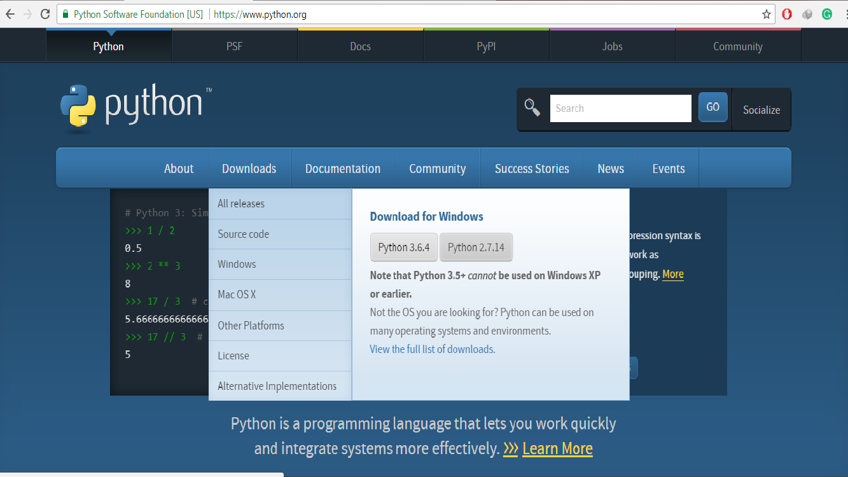

Slide 18

Keywords in Python

Slide 19
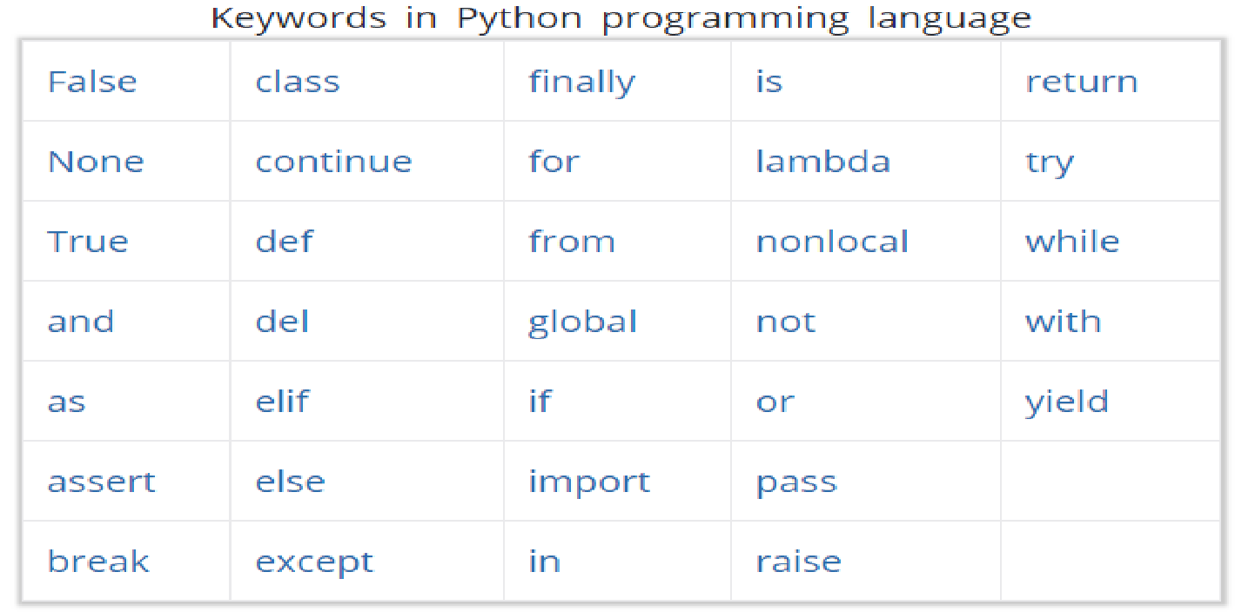
Keywords in Python :

Slide 20
Operators in Python

Slide 21
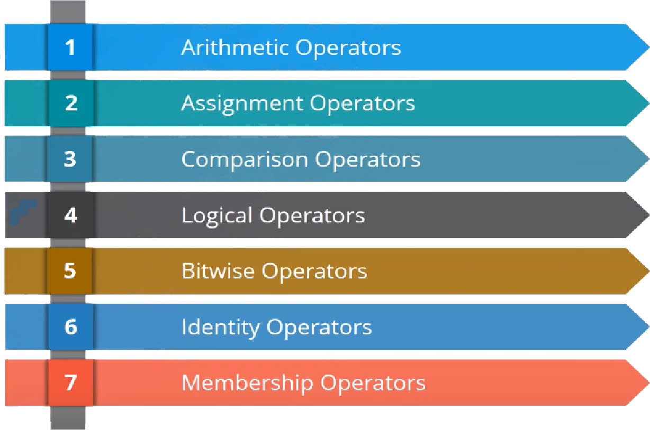
Operators in Python

Slide 22
Arithmetic Operators

Slide 23
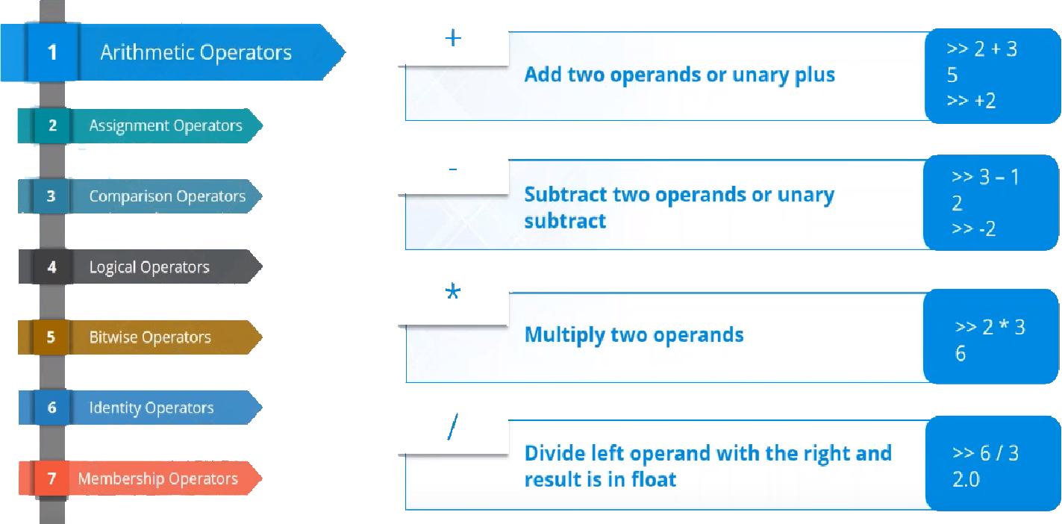
Arithmetic Operators :

Slide 24
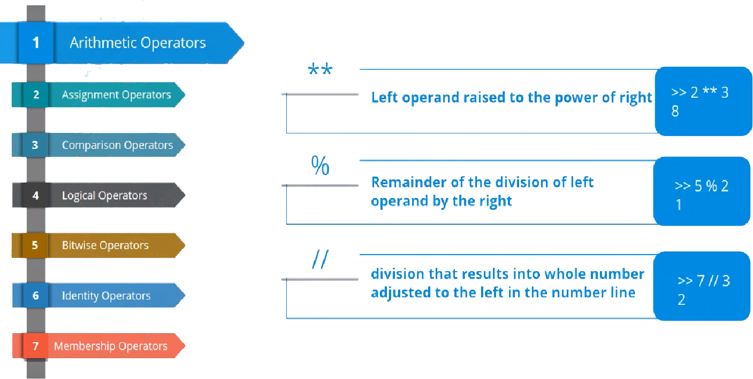
Arithmetic Operators :

Slide 25
Assignment Operators

Slide 26
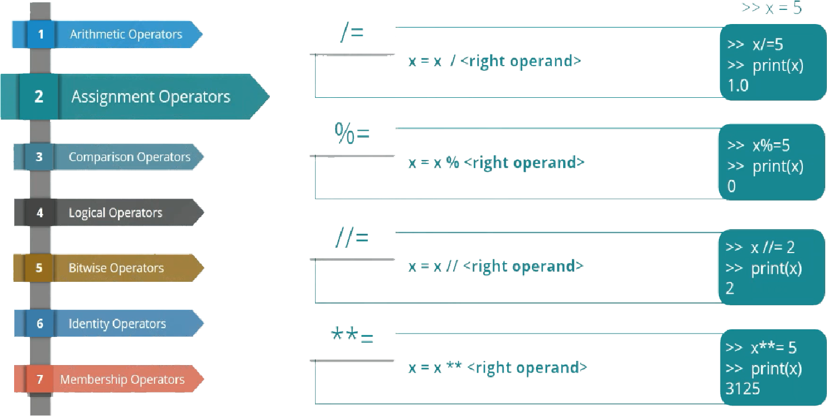
Assignment Operators :

Slide 27
Comparison Operators

Slide 28
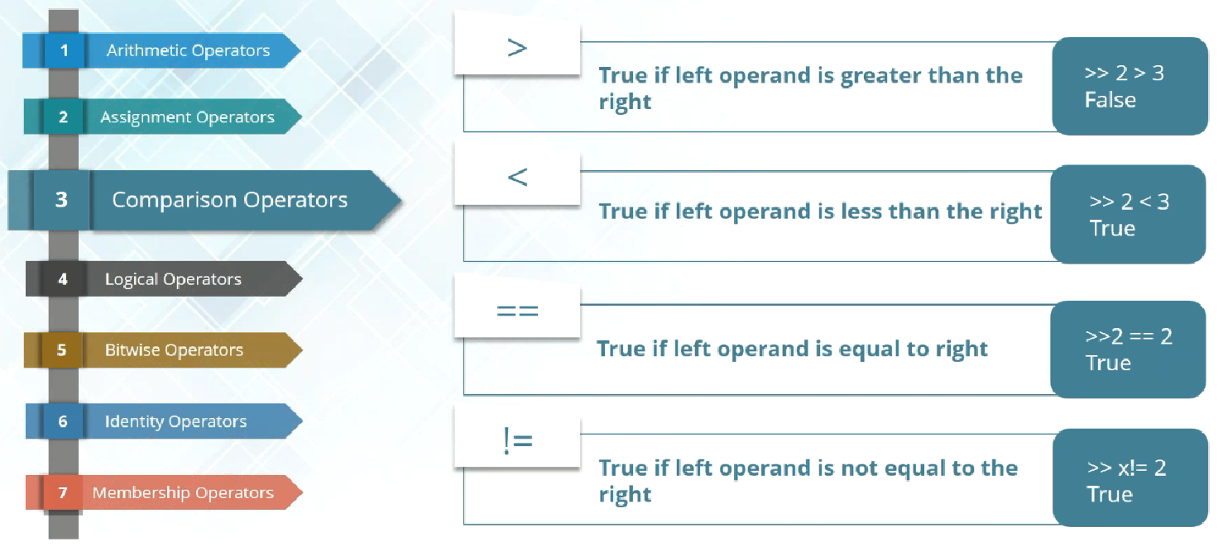
Comparison Operators :

Slide 29
Logical Operators

Slide 30
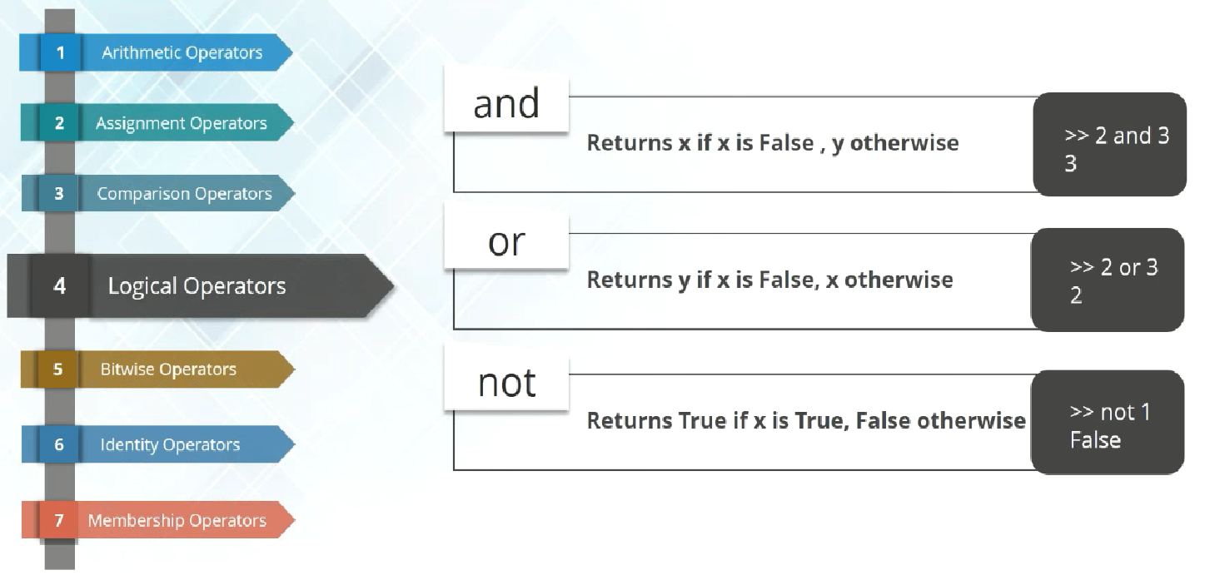
Logical Operators :

Slide 31
Bitwise Operators

Slide 32
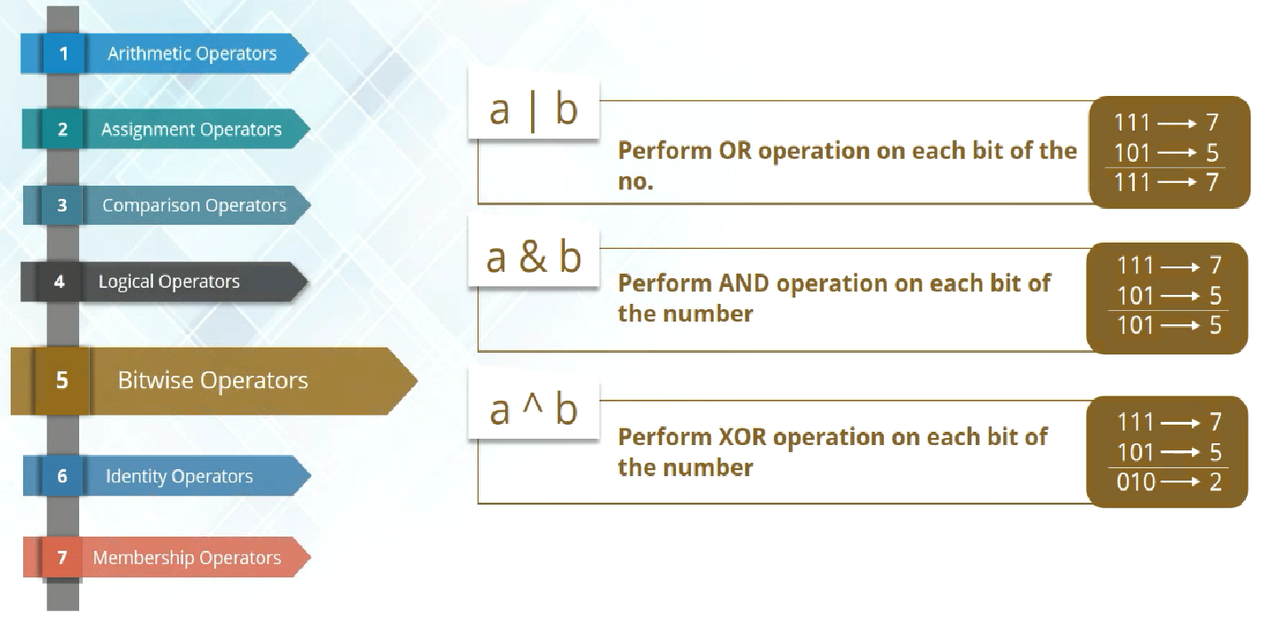
Bitwise Operators :

Slide 33
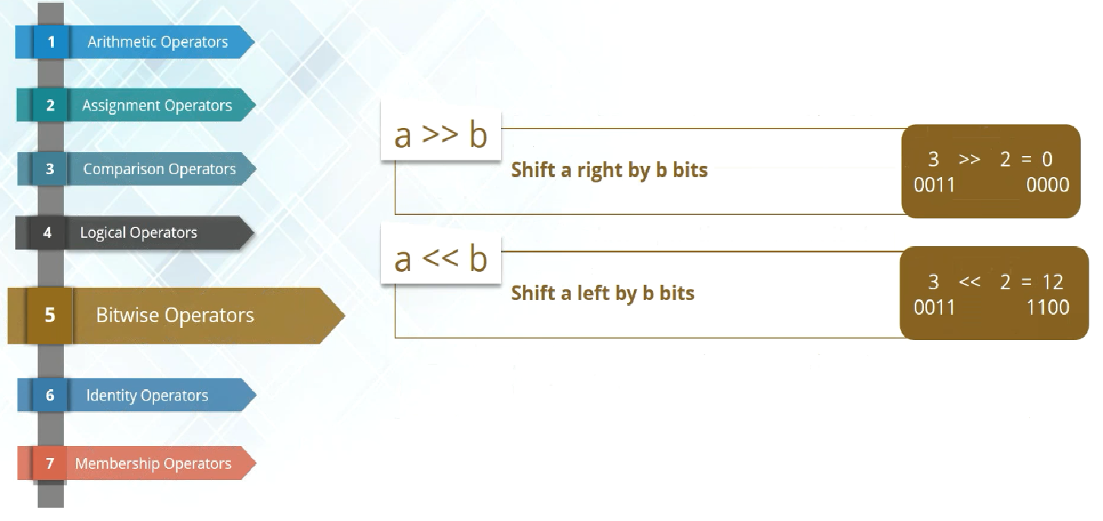
Bitwise Operators :

Slide 34
Identity Operators

Slide 35
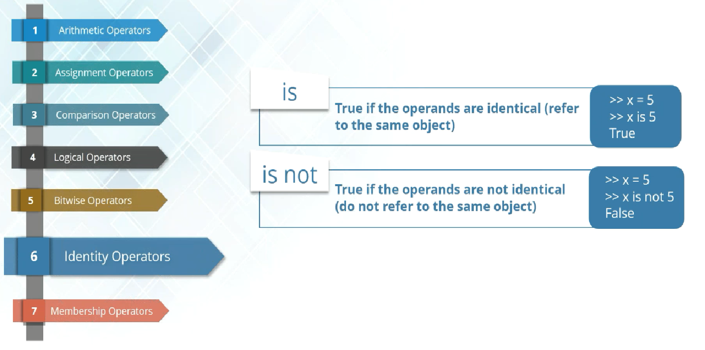
Identity Operators :

Slide 36
Membership Operators

Slide 37
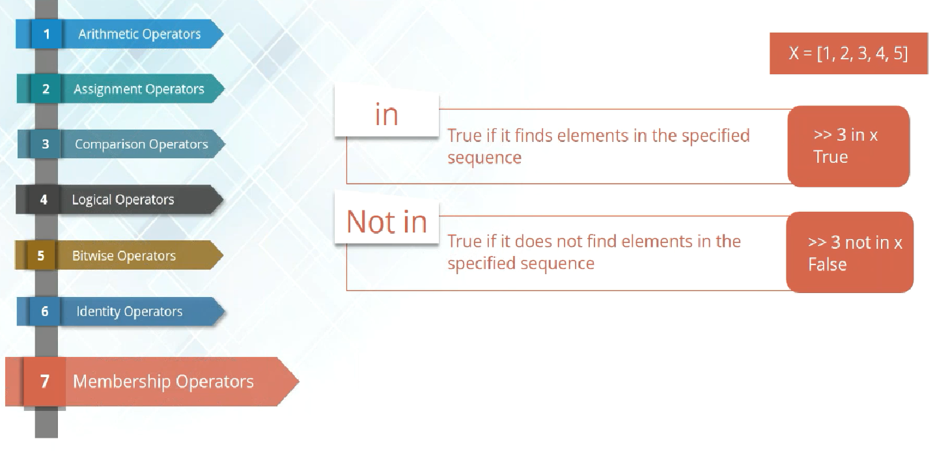
Membership Operators :

Slide 38

Flow Control

Slide 39
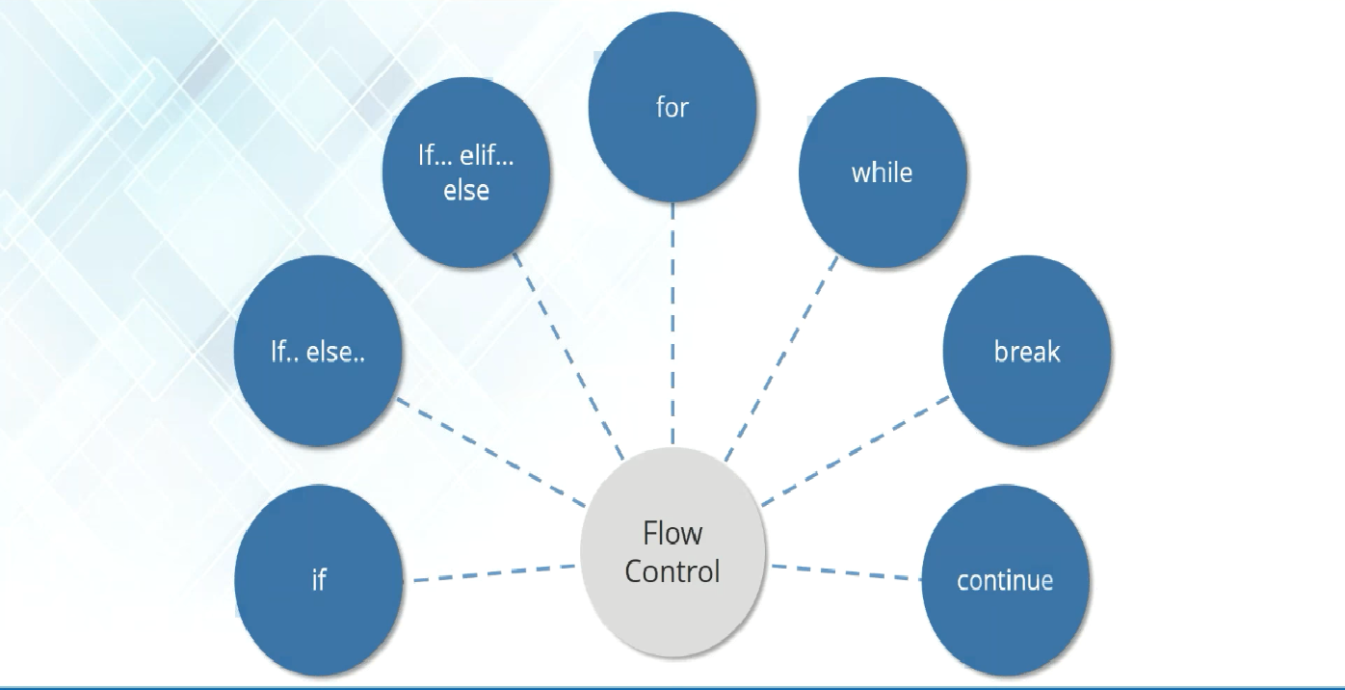

Slide 40
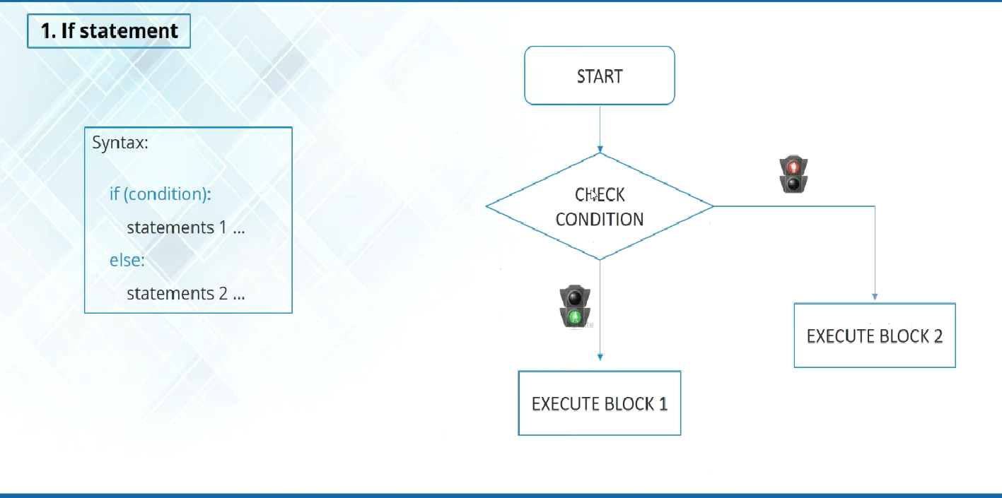
Flow Control :

Slide 41
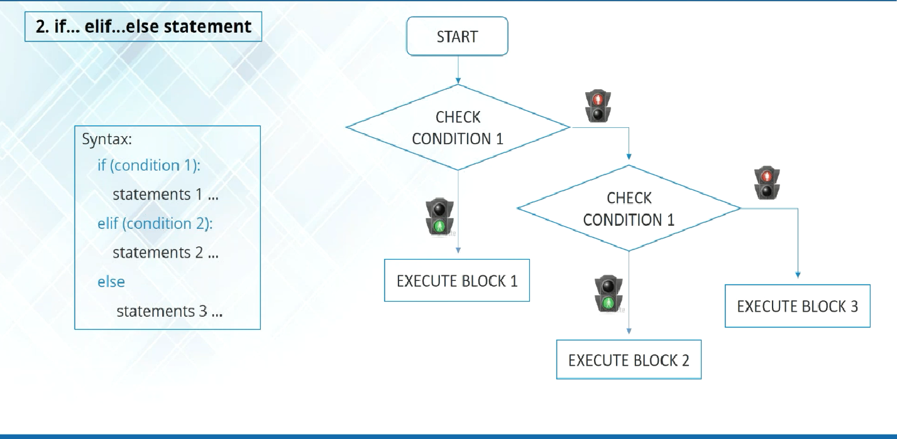
Flow Control :

Slide 42
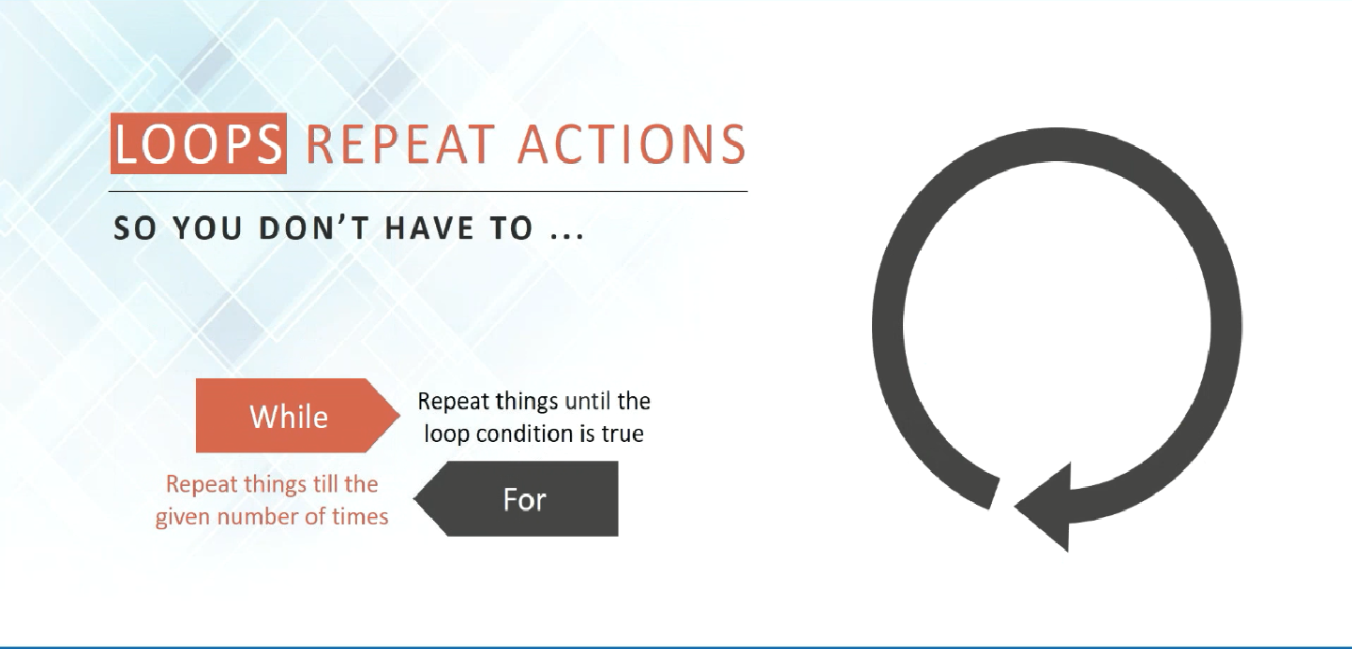
Flow Control :

Slide 43
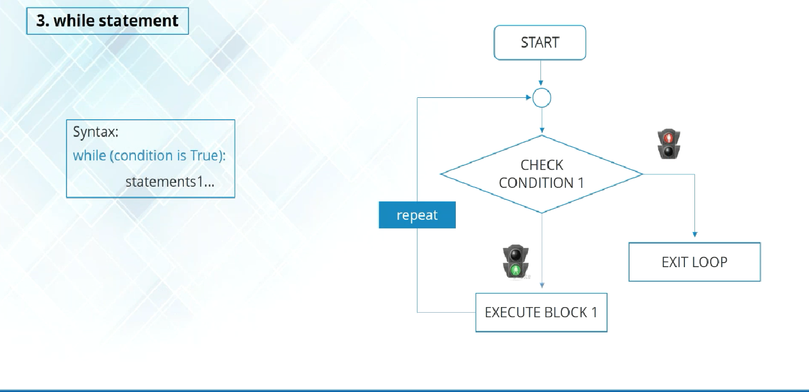
Flow Control :

Slide 44
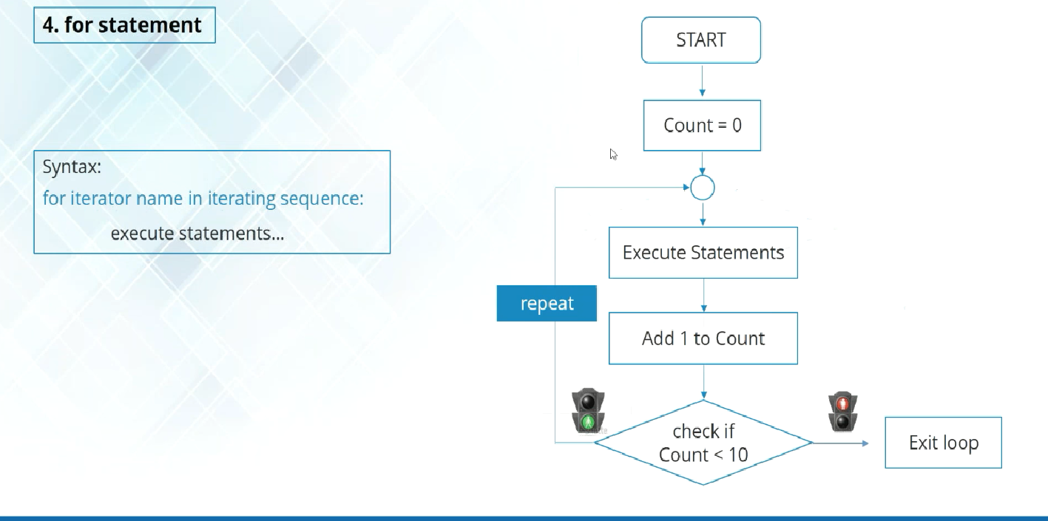
Flow Control :

Slide 45
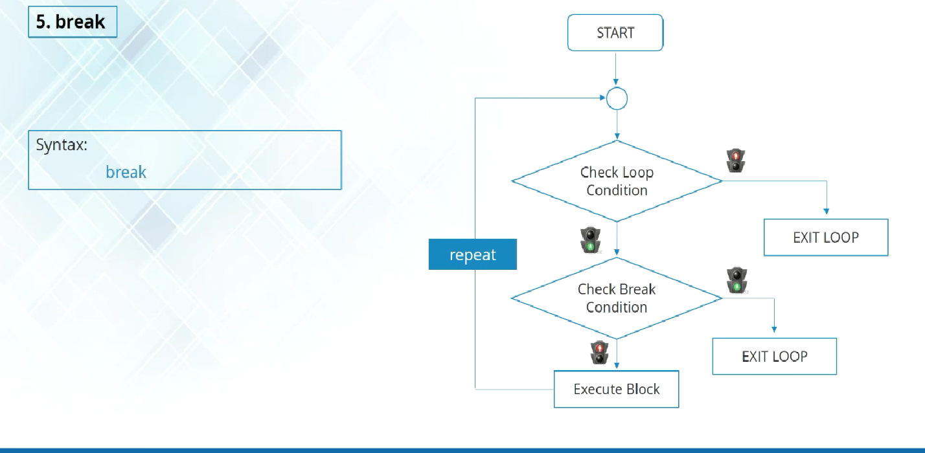
Flow Control :

Slide 46
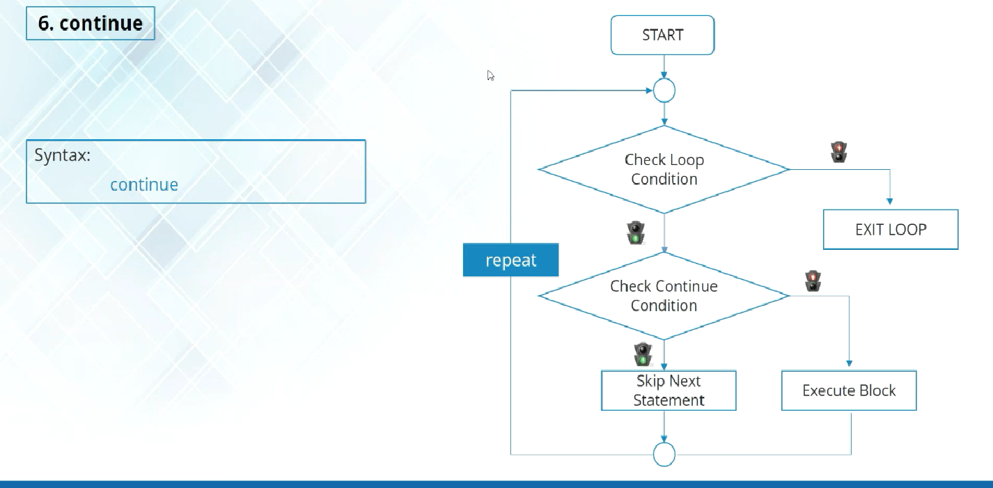
Flow Control :

